Slide 1



SnapCv
Group 55
Ananya- IIT2021061
Aditya Sharma - IIT2021041
Atharva Gadekar- IIT2021049
Submitted to: Prof O P Vyas , Prof Sonali Agarwal , Prof Rahul Kala
Mentored by: Bagesh Kumar Sir and Ashutosh Kumar Sir

Slide 2
Contents
Abstract
What if we want to extend the Project?
Class Diagram and Explanation
Use Case Diagram and Explanation
CRC Diagram and Explanation
Code Explanation
Snaps of UI Model
Execution

Slide 3

Abstract
It is an application that simplifies the task of creating a resume for individuals. This application is flexible to be used and reduces the need of thinking and designing an appropriate resume according to qualifications. This project is developed to provide an easy means for creating a professional looking resume. Users just have to fill up a form that specifies questions from all required fields such as personal questions, educational, qualities, interest, skills and so on. The answers provided by the users are stored and the system automatically generates a well-structured resume.
Technologies used: Java, JavaFX.

Slide 4
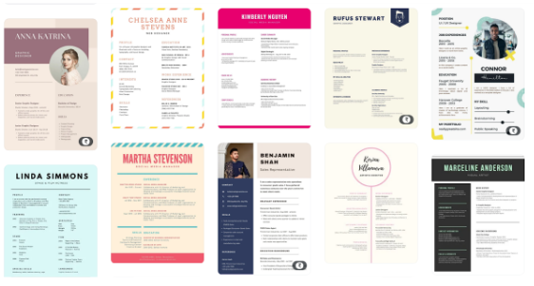
What if we want to extend the project?
We can improve the project such that the user gets to choose custom templates before filling his/her details.
We can add more file extensions.
We can modify the text styling and font size according to our choices.
We can fetch the user's data and save it in a database so that he/she can edit the resume whenever needed.

Slide 5
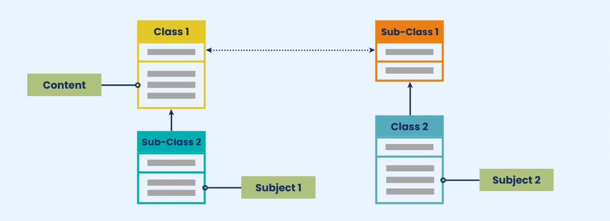
Class Diagram

Slide 6
Class Diagram
Class diagram is a static diagram. It represents the static view of an application. Class diagram is not only used for visualizing, describing, and documenting different aspects of a system but also for constructing executable code of the software application.
The purpose of the class diagram can be summarized as −
Analysis and design of the static view of an application.
Describe responsibilities of a system.
Base for component and deployment diagrams.
Forward and reverse engineering.

Slide 7
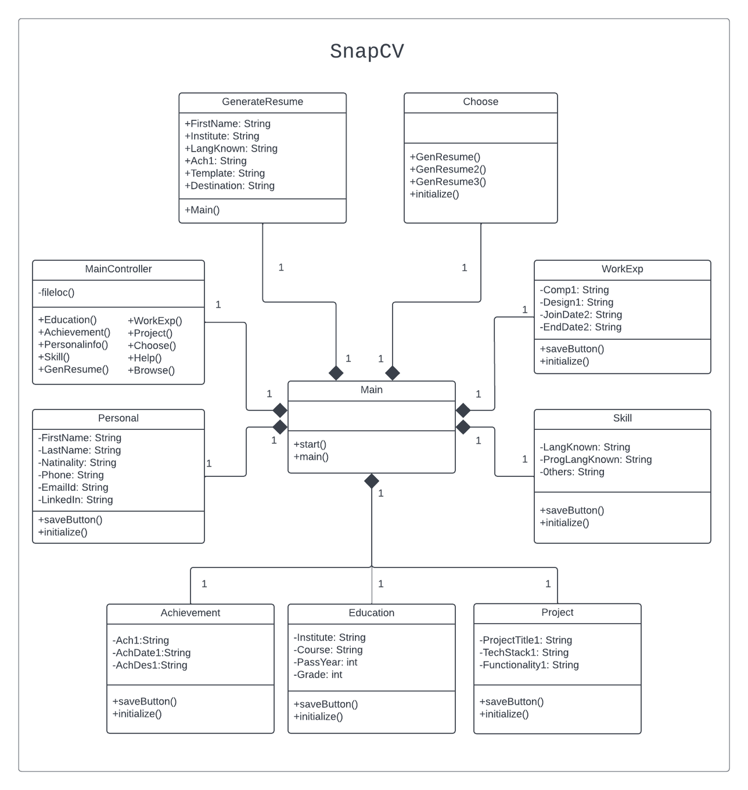

Slide 8
Main Class:
CLASS DIAGRAM EXPLANATION
The first class which executes on running the program is the Main class. The main function in this class calls the start() method. It loads the ResumeUI.fxml file in a new window (Stage / Frame)
Following are the classes in our class diagram:
Main
MainController
Education
Achievement
Choose
Help
Skill
Project
WorkExp
GenerateResume
Personal
Main Controller Class
It handles all the actions events for the buttons in the ResumeUI.fxml file using the various functions associated with these buttons. Eg, the Education() function is executed upon clicking the Education button in the Home Screen. This function then makes a new stage and loads the Education.fxml file. Other functions are executed accordingly on clicking their respective buttons.
Choose Class :
The Choose class is used to update the Template variable (of the GenerateResume class). It allows the program to know which template the user wishes to use.

Slide 9
Education, Skill, Project Class :
CLASS DIAGRAM EXPLANATION
These classes have main functions which essentially do the same job. They collect information from the user using text-fields and assign these values to the global variables of the GenerateResume.
Following are the classes in our class diagram:
Main
MainController
Education
Achievement
Choose
Help
Skill
Project
WorkExp
GenerateResume
Personal
GenerateResume Class :
Upon clicking the Generate Resume button on the Home Screen, the GenResume() function is executed in the MainController. This function inturn calls the main() function of the GenerateResume class. This class stores the inputs of the user in global variables. Its main function generates the required HTML for the Final Resume and converts it to PDF.
Personal, WorkExp, Achievements Class :
These classes have main functions which essentially do the same job. They collect information from the user using textfields and assign these values to the global variables of the GenerateResume.

Slide 10
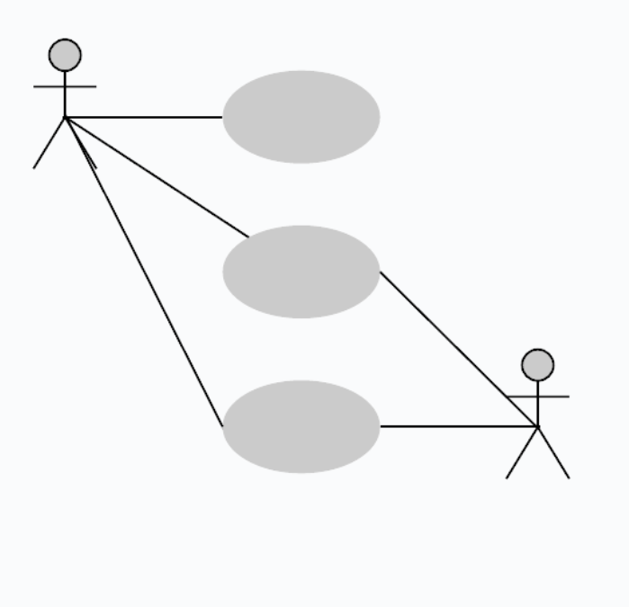
Use Case Diagram
A use case diagram is used to represent the dynamic behavior of a system. It encapsulates the system's functionality by incorporating use cases, actors, and their relationships. It models the tasks, services, and functions required by a system/subsystem of an application. It depicts the high-level functionality of a system and also tells how the user handles a system.

Slide 11
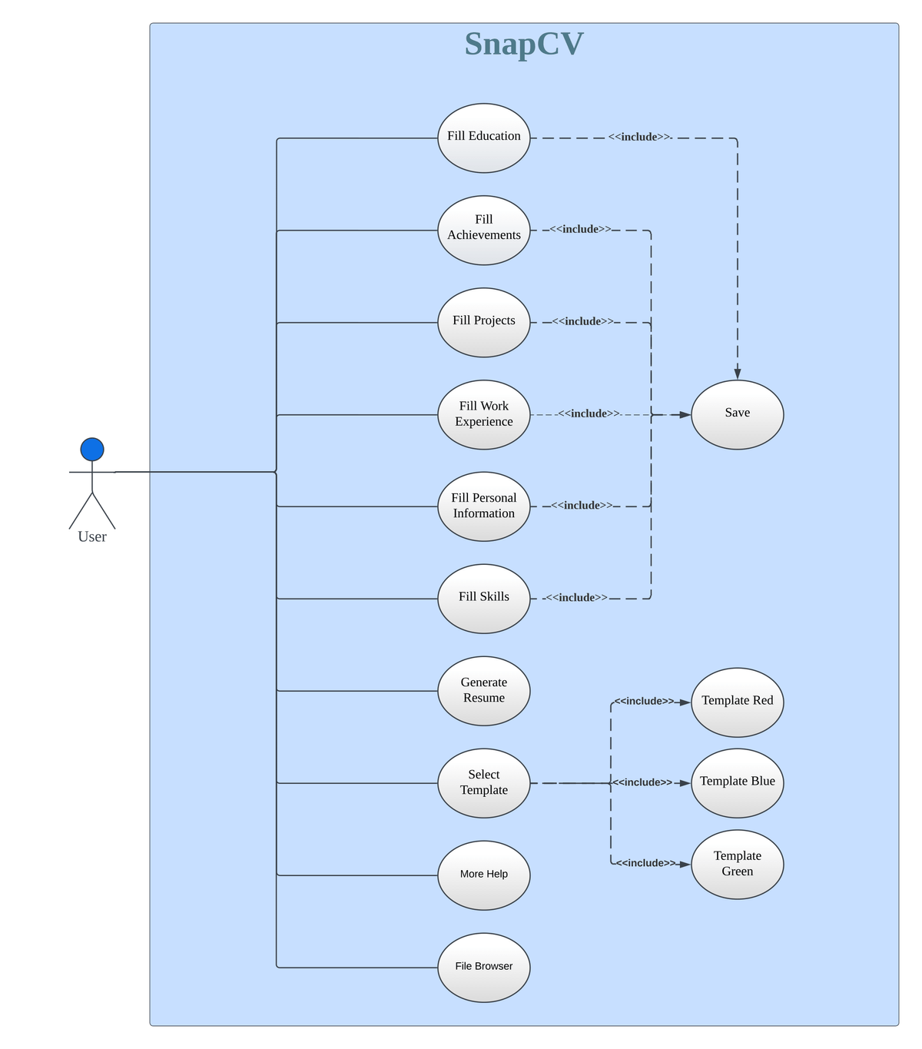



Slide 12
USE CASE EXPLANATION
Firstly the user will fill all the details about his/her education, achievements, projects, work experience, personal information and skills .
In this use case diagram the only actor is user and use cases are:
Fill Education
Fill Skills
Fill Achievements
Fill Work Experience
Fill Projects
Fill Personal Information
Generate Resume
Select Template
More Help
File Browser
Template Red
Template Blue
Template Green
Save
After filling these informations,the user will be allowed to click on the save button.The user can select which type of template he/she wants by clicking on the select template option.
There are three options provided for the same named Template Red, Template Blue, Template Green.If the user needs some help regarding the workflow of the SnapCv then he/she can click on More Help button which will be redirected to a youtube link.
After completing all the above steps user will select the location where he/she wants to save the resume on the computer and finally click on generate Resume button.

Slide 13
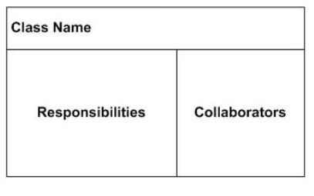
CRC Diagram
A Class-Responsibility Collaborator(CRC) model is a collection of CRC cards that represent whole or part of an application or problem domain.

Slide 14
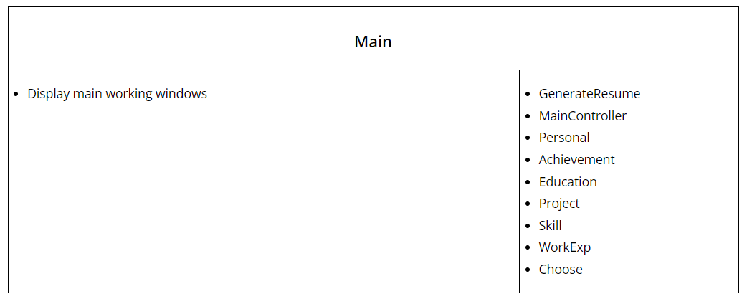
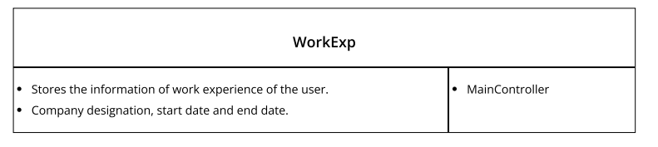

Slide 15
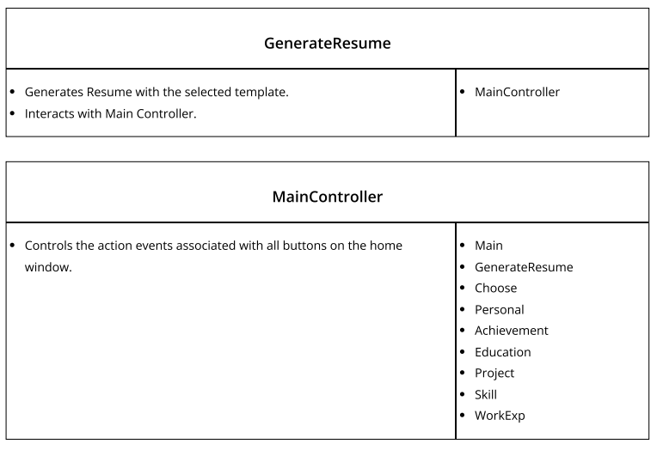
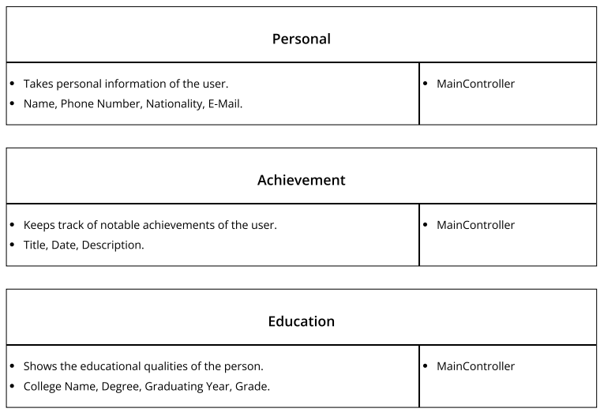
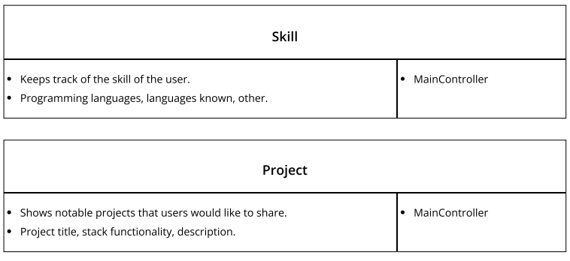
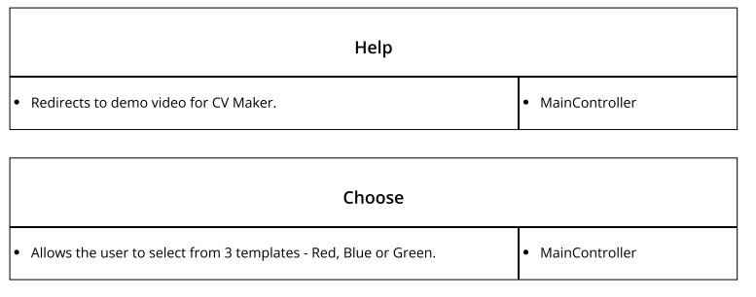

Slide 16

Code Explanation

Slide 17
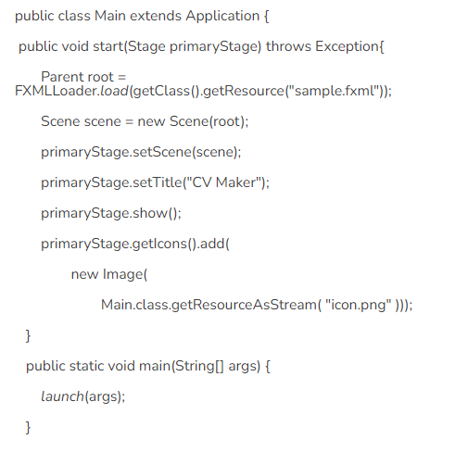
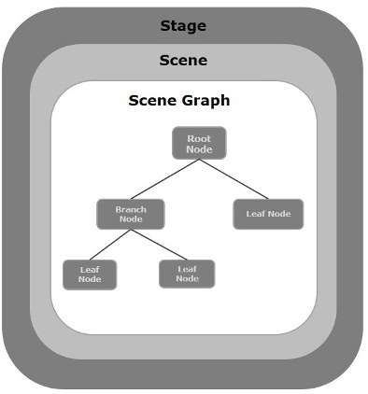

Slide 18
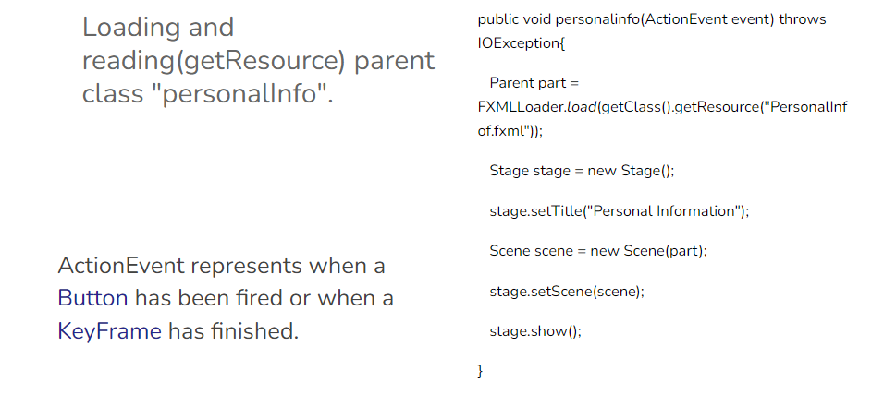

Slide 19
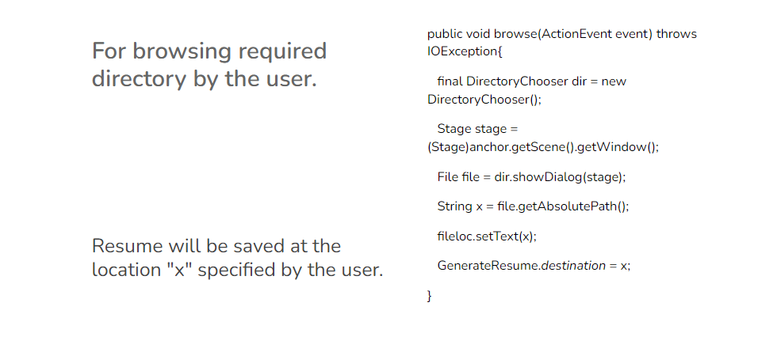

Slide 20
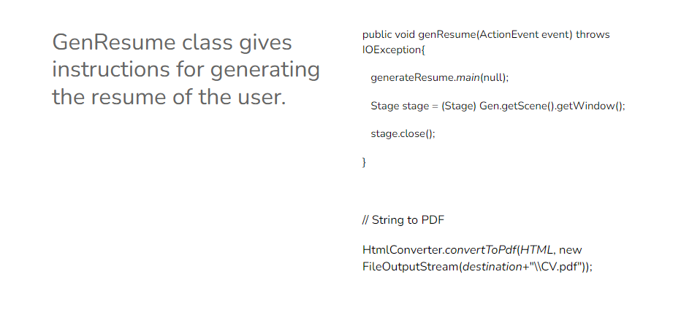

Slide 21

Snaps of UI Model

Slide 22
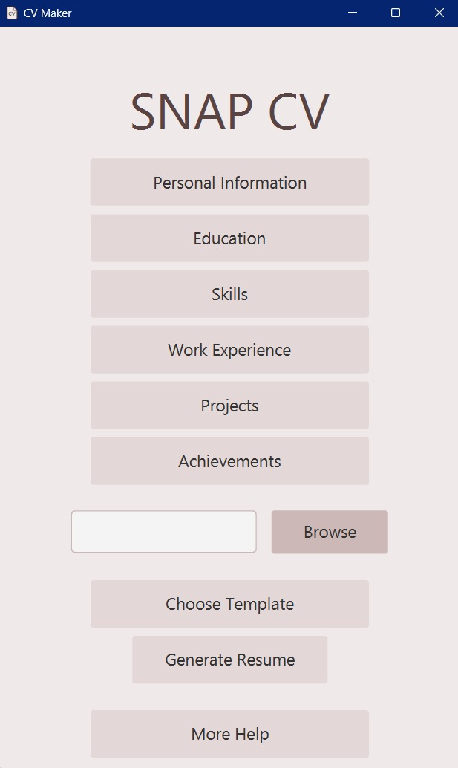
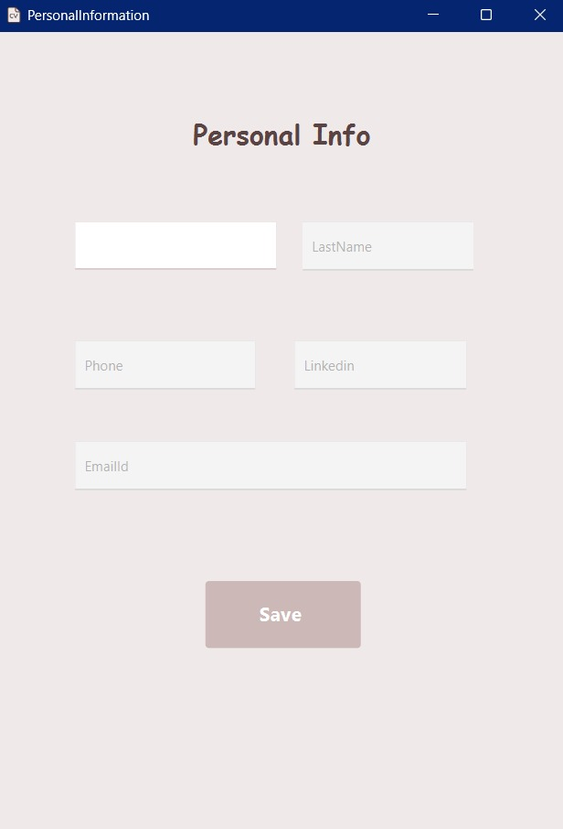

Slide 23
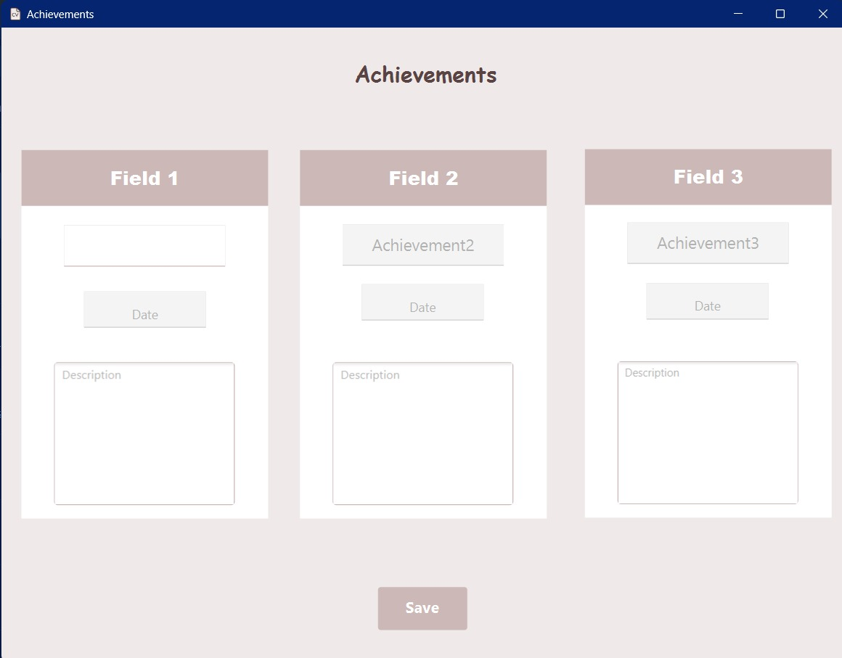

Slide 24
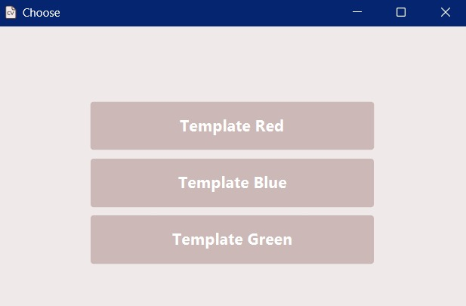
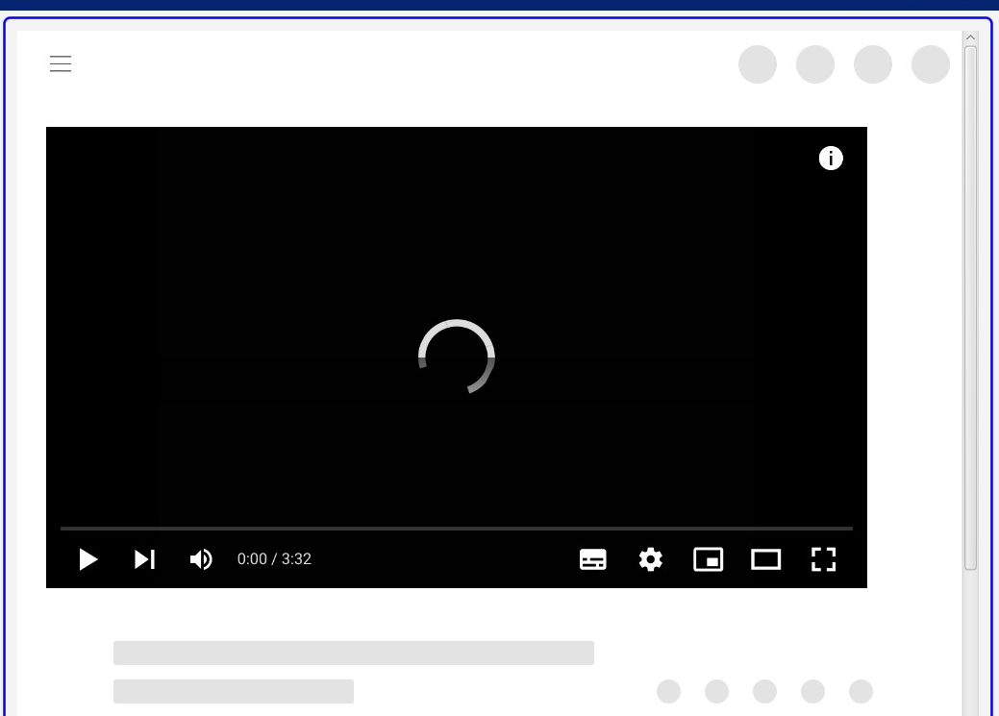

Slide 25
Thank You

